Slide 1
ISTANBUL UNIVERSITY
Dept. of Computer Engineering
Computer Arithmetic Algorithms
Part 1
Introduction

Slide 2
Prerequisites and textbook
Prerequisites: courses in
  Digital Design
  Computer Organization/Architecture
Textbook: Computer Arithmetic Algorithms, I. Koren, 2nd Edition, A.K. Peters, Natick, MA, 2002
Textbook web page: http://www.ecs.umass.edu/ece/koren/arith
Recommended Reading:
  B. Parhami, Computer Arithmetic: Algorithms and Hardware Design, Oxford University Press, 2000
  M. Ercegovac and T. Lang, Digital Arithmetic, Morgan Kaufman, 2003

Slide 3
Administrative Details
Instructor:Prof. Ahmet Sertbaş
Office: Tel. 473 70 70 - 17902
Email: asertbas@istanbul.edu.tr
Grading: Undergraduated
      Homework - 20% (yıliçi)
      Project- 30%
      Final 50 %

Slide 4
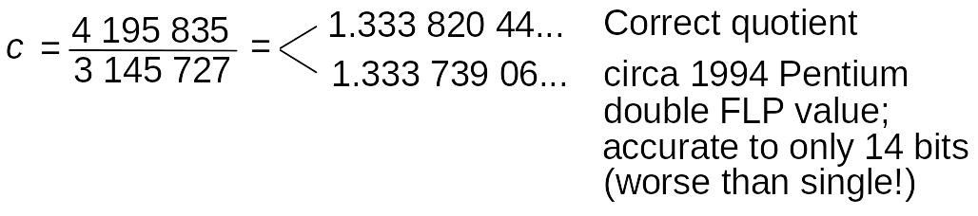
What is Computer Arithmetic?
Pentium Division Bug (1994-95): Pentium’s radix-4 SRT algorithm occasionally gave incorrect quotient
First noted in 1994 by T. Nicely who computed sums of reciprocals of twin primes:
1/5 + 1/7 + 1/11 + 1/13 + . . . + 1/p + 1/(p + 2) + . . .
Worst-case example of division error in Pentium:

Slide 5
Top Ten Intel Slogans for the Pentium
Humor, circa 1995
9.999 997 325 It’s a FLAW, dammit, not a bug
8.999 916 336 It’s close enough, we say so
7.999 941 461 Nearly 300 correct opcodes
6.999 983 153 You don’t need to know what’s inside
5.999 983 513 Redefining the PC –– and math as well
4.999 999 902 We fixed it, really
3.999 824 591 Division considered harmful
2.999 152 361 Why do you think it’s called “floating” point?
1.999 910 351 We’re looking for a few good flaws
0.999 999 999 The errata inside

Slide 6
Finite Precision Can Lead to Disaster
Example: Failure of Patriot Missile (1991 Feb. 25)
Source http://www.math.psu.edu/dna/455.f96/disasters.html
American Patriot Missile battery in Dharan, Saudi Arabia, failed to intercept inoming Iraqi Scud missile
The Scud struck an American Army barracks, killing 28
Cause, per GAO/IMTEC-92-26 report: “software problem” (inaccurate calculation of the time since boot)
Problem specifics:
Time in tenths of second as measured by the system’s internal clock was multiplied by 1/10 to get the time in seconds
Internal registers were 24 bits wide
1/10 = 0.0001 1001 1001 1001 1001 100 (chopped to 24 b)
Error ≈ 0.1100 1100 × 2^{–23} ≈ 9.5 × 10^{–8}
Error in 100-hr operation period
≈ 9.5 × 10 –8 × 100 × 60 × 60 × 10 = 0.34 s
Distance traveled by Scud = (0.34 s) × (1676 m/s) ≈ 570 m

Slide 7
Finite Range Can Lead to Disaster
Example: Explosion of Ariane Rocket (1996 June 4)
Source http://www.math.psu.edu/dna/455.f96/disasters.html
Unmanned Ariane 5 rocket of the European Space Agency veered off its flight path, broke up, and exploded only 30 s after lift-off (altitude of 3700 m)
The $500 million rocket (with cargo) was on its first voyage after a decade of development costing $7 billion
Cause: “software error in the inertial reference system”
Problem specifics:
A 64 bit floating point number relating to the horizontal velocity of the rocket was being converted to a 16 bit signed integer
An SRI* software exception arose during conversion because the 64-bit floating point number had a value greater than what could be represented by a 16-bit signed integer (max 32 767)
*SRI = Système de Référence Inertielle or Inertial Reference System

Slide 8
Aspects of, and Topics in, Computer Arithmetic
Hardware (our focus in this book) Software
––––––––––––––––––––––––––––––––––––––––––––––––– ––––––––––––––––––––––––––––––––––––
Design of efficient digital circuits for Numerical methods for solving
primitive and other arithmetic operations systems of linear equations,
such as +, –, ×, ÷, √, log, sin, cos partial differential equations, etc.
Issues: Algorithms Issues: Algorithms
Error analysis Error analysis
Speed/cost trade-offs Computational complexity
Hardware implementation Programming
Testing, verification Testing, verification
General-purpose Special-purpose
–––––––––––––––––––––– –––––––––––––––––––––––
Flexible data paths Tailored to
Fast primitive applications like:
operations like Digital filtering
+, –, ×, ÷, √ Image processing
Benchmarking Radar tracking
Fig. 1.1 The scope of computer arithmetic.

Slide 9
Course Outline
Number systems and basic arithmetic operations
Unconventional fixed-point number systems
Sequential algorithms for multiplication and division
Floating-point arithmetic
Algorithms for fast addition
High-speed multiplication
Fast division
Division through multiplication
Efficient algorithms for evaluation of elementary functions.
Logarithmic number systems.
The residue number system; error correction and detection in
arithmetic operations, .

Slide 10
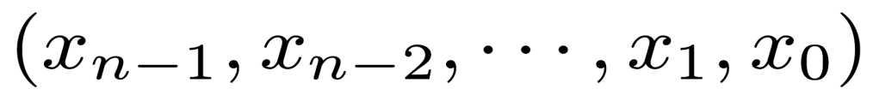
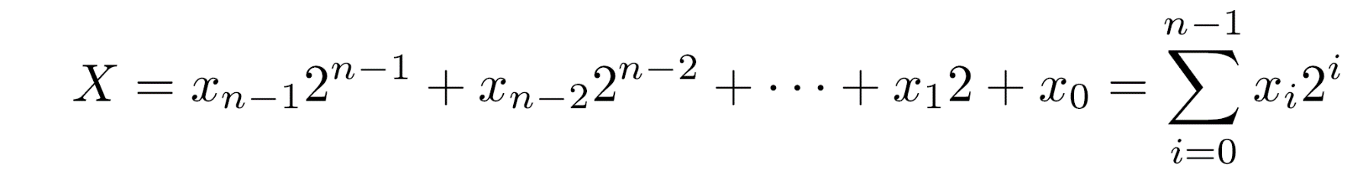
The Binary Number System
In conventional digital computers - integers represented as binary numbers of fixed length n
An ordered sequence of binary digits
Each digit x (bit) is 0 or 1
The above sequence represents the integer value X
Upper case letters represent numerical values or sequences of digits
Lower case letters, usually indexed, represent individual digits
i

Slide 11
Radix of a Number System
The weight of the digit x is the i th power of 2
2 is the radix of the binary number system
Binary numbers are radix-2 numbers - allowed digits are 0,1
Decimal numbers are radix-10 numbers - allowed digits are 0,1,2,…,9
Radix indicated in subscript as a decimal number
Example:
  (101) - decimal value 101
  (101) - decimal value 5
i
10
2

Slide 12
Range of Representations
Operands and results are stored in registers of fixed length n - finite number of distinct values that can be represented within an arithmetic unit
Xmin ; Xmax - smallest and largest representable values
[Xmin,Xmax] - range of the representable numbers
A result larger then Xmax or smaller than Xmin - incorrectly represented
The arithmetic unit should indicate that the generated result is in error - an overflow indication

Slide 13
Example - Overflow in Binary System
Unsigned integers with 5 binary digits (bits)
  Xmax = (31)10 - represented by (11111)2
  Xmin = (0)10 - represented by (00000)2
  Increasing Xmax by 1 = (32)10 =(100000)2
  5-bit representation - only the last five digits retained - yielding (00000)2 =(0)10
In general -
  A number X not in the range [Xmin,Xmax]=[0,31] is represented by X mod 32
  If X+Y exceeds Xmax - the result is S = (X+Y) mod 32
Example: X 10001 17 +Y 10010 18 1 00011 3 = 35 mod 32
  Result has to be stored in a 5-bit register - the most significant bit (with weight 2 =32) is discarded
5

Slide 14
Machine Representations of Numbers
Binary system - one example of a number system that can be used to represent numerical values in an arithmetic unit
A number system is defined by the set of values that each digit can assume and by an interpretation rule that defines the mapping between the sequences of digits and their numerical values
Types of number systems -
conventional (e.g.,binary, decimal)
unconventional (e.g., signed-digit number system)

Slide 15
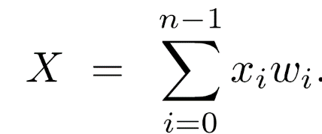
Conventional Number Systems
Properties of conventional number systems:
Nonredundant -
  Every number has a unique representation, thus
  No two sequences have the same numerical value
Weighted -
  A sequence of weights wn-1,wn-2,...,w1,w0 determines the value of the n-tuple xn-1,xn-2,...,x1,x0 by
  wi - weight assigned to xi - digit in ith position
Positional -
  The weight wi depends only on the position i of digit xi
  wi = r
i

Slide 16
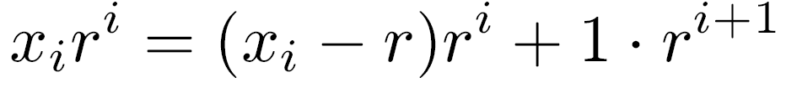
Fixed Radix Systems
r - the radix of the number system
Conventional number systems are also called fixed-radix systems
With no redundancy - 0 ≤ xi ≤ r-1
xi ≥ r introduces redundancy into the fixed-radix number system
If xi ≥ r is allowed -
two machine representations for the same value -(...,xi+1,xi,... ) and (...,xi+1+1,xi-r,... )

Slide 17
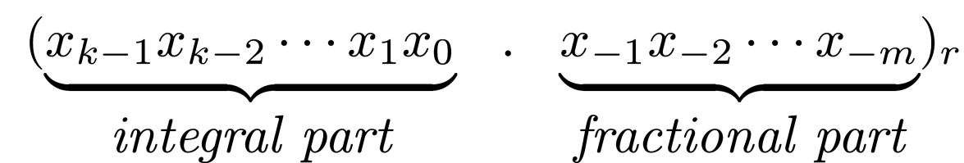
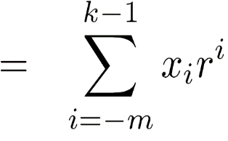
Representation of Mixed Numbers
A sequence of n digits in a register - not necessarily representing an integer
Can represent a mixed number with a fractional part and an integral part
The n digits are partitioned into two - k in the integral part and m in the fractional part (k+m=n)
The value of an n-tuple with a radix point between the k most significant digits and the m least significant digits
is

Slide 18
Fixed Point Representations
Radix point not stored in register - understood to be in a fixed position between the k most significant digits and the m least significant digits
  These are called fixed-point representations
Programmer not restricted to the predetermined position of the radix point
  Operands can be scaled - same scaling for all operands
Add and subtract operations are correct -
  aX ± aY=a(X ± Y) (a - scaling factor)
Corrections required for multiplication and division
  aX • aY=a X • Y ; aX/aY=X/Y
Commonly used positions for the radix point -
  rightmost side of the number (pure integers - m=0)
  leftmost side of the number (pure fractions - k=0)
2

Slide 19
ULP - Unit in Last Position
-m
Given the length n of the operands, the weight r of the least significant digit indicates the position of the radix point
Unit in the last position (ulp) - the weight of the least significant digit
ulp = r
This notation simplifies the discussion
No need to distinguish between the different partitions of numbers into fractional and integral parts
-m

Slide 20
Radix Conversions
Translating a number X represented in one radix number system (source number system) to its representation in another number system (destination)
Main reason - most arithmetic units operate on binary numbers, while users are accustomed to decimal numbers (requiring fewer digits)
Given a number X, find its representation in the destination number system with radix r
We distinguish between the conversion of the integral part X and the fractional part X
D
I
F

Slide 21

Conversion of Integral Part
Seeking
Dividing X by r
  remainder - x
  quotient -
Dividing the quotient by r → x is the remainder
Dividing the quotients repeatedly by r until a zero quotient is obtained - the remainders are the required digits
I
D
0
D
1
D

Slide 22


Conversion of Fractional Part
Seeking
Multiplying XF by rD we obtain a mixed number
  x is the integral part
  is the fractional part
Fractional parts multiplied repeatedly by rD, generated integers are the required digits
Algorithm not guaranteed to terminate
  Finite fraction in one number system may correspond to an infinite fraction in another
  In practice - the process can be terminated after m steps (or a few additional ones for rounding)
-1

Slide 23
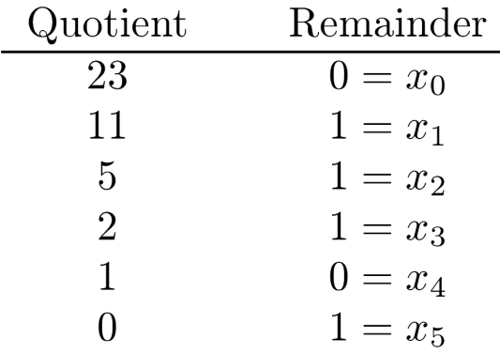
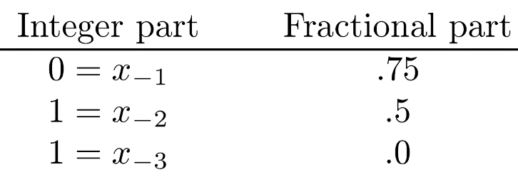
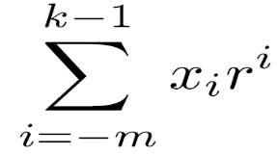
Example - Decimal to Binary Conversion
Converting the decimal mixed number X=46.37510 to binary form
XI=46 - quotients and remainders when repeatedly dividing by 2:
XF=0.375 - integers and fractions when repeatedly multiplying by 2:
Final result - 46.37510=101110.0112
If (decimal) fractional part is XF=0.3 - the algorithm never terminates - results in an infinite binary fraction 0.0100110011...2
All arithmetic operations were performed in source system - decimal
For binary to decimal conversion
  either perform the algorithm in the source binary system
  or, more conveniently, use X =
perform the conversion in the destination decimal system
using equation (\ref{eq:3}).

Slide 24
Representation of Negative Numbers
Fixed-point numbers in a radix r system
Two ways of representing negative numbers:
Sign and magnitude representation (or signed-magnitude representation)
Complement representation with two alternatives
  Radix complement (two's complement in the binary system)
  Diminished-radix complement (one's complement in the binary system)

Slide 25
Signed-Magnitude Representation
Sign and magnitude are represented separately
First digit is the sign digit, remaining n-1 digits represent the magnitude
Binary case - sign bit is 0 for positive, 1 for negative numbers
Non-binary case - 0 and r-1 indicate positive and negative numbers
Only 2r out of the r possible sequences are utilized
n-1
n

Slide 26
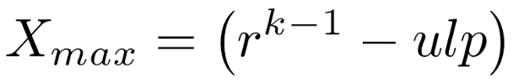

Range of Representable Numbers
n-1 digits representing magnitude - partitioned into k-1 and m digits in integral and fractional parts
Largest representable value is where with representation 0 (r-1) ⋅⋅⋅ (r-1)
Range of positive numbers is [0,r - ulp]
Range of negative numbers is [-(r - ulp),-0] represented by (r-1) (r-1) ⋅⋅⋅ (r-1) to (r-1) 0 ⋅⋅⋅ 0
Two representations for zero - positive and negative
Inconvenient when implementing an arithmetic unit - when testing for zero, the two different representations must be checked
k-1
k-1

Slide 27
Range of Binary System
All 2 sequences are utilized
2 sequences from 00 ⋅⋅⋅ 0 to 01 ⋅⋅⋅ 1 represent positive numbers
Remaining 2 sequences from 10 ⋅⋅⋅ 0 to 11 ⋅⋅⋅ 1 represent negative numbers
If k=n (m=0 and ulp=2 =1)
  range of positive numbers is [0,2 - 1]
  range of negative numbers is [-(2 - 1), -0]
n
n-1
n-1
0
n-1
n-1

Slide 28
Disadvantage of the Signed-Magnitude Representation
Operation may depend on the signs of the operands
Example - adding a positive number X and a negative number -Y : X+(-Y)
If Y>X, final result is -(Y-X)
Calculation -
  switch order of operands
  perform subtraction rather than addition
  attach the minus sign
A sequence of decisions must be made, costing excess control logic and execution time
This is avoided in the complement representation methods

Slide 29
Complement Representations of Negative Numbers
Two alternatives -
  Radix complement (called two's complement in the binary system)
  Diminished-radix complement (called one's complement in the binary system)
In both complement methods - positive numbers represented as in the signed-magnitude method
A negative number -Y is represented by R-Y where R is a constant
This representation satisfies -(-Y )=Y since R-(R-Y)=Y

Slide 30
Advantage of Complement Representation
No decisions made before executing addition or subtraction
Example: X-Y=X+(-Y)
-Y is represented by R-Y
Addition is performed by X+(R-Y) = R-(Y-X)
If Y>X, -(Y-X) is already represented as R-(Y-X)
No need to interchange the order of the two operands

Slide 31
Requirements for Selecting R
If X>Y - the result is X+(R-Y)=R+(X-Y) instead of X-Y - additional R must be discarded
R selected to simplify or eliminate this correction
Another requirement - calculation of the complement R-Y should be simple and done at high speed
Definitions:
Complement of a single digit xi
xi = (r-1)- xi
Complement of an n-tuple X
X = (xk-1,xk-2,...,x-m) obtained by complementing every digit in the sequence corresponding to X
-
-
-
-
-

Slide 32
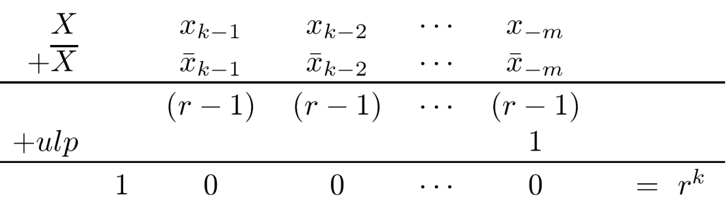
Selecting R in Radix-Complement Rep.
-
k
X+X+ulp = r
Result stored into a register of length n(=k+m)
Most significant digit discarded - final result is zero
In general, storing the result of any arithmetic operation into a fixed-length register is equivalent to taking the remainder after dividing by r
r - X = X + ulp
Selecting R = r : R - X = r - X = X + ulp
Calculation of R-X - simple and independent of k
This is radix-complement representation
R=r discarded when calculating R+(X-Y) - no correction needed when X+(R-Y) is positive (X>Y)
k
-
k
k
-
k
k

Slide 33
Example - Two’s Complement
0
r=2, k=n=4, m=0, ulp=2 =1
Radix complement (called two's complement in the binary case) of a number X = 2 - X
It can instead be calculated by X+1
0000 to 0111 represent positive numbers 010 to 710
  The two's complement of 0111 is 1000+1=1001 - it represents the value (-7)10
  The two's complement of 0000 is 1111+1=10000=0 mod 2 - single representation of zero
Each positive number has a corresponding negative number that starts with a 1
1000 representing (-8)10 has no corresponding positive number
Range of representable numbers is -8 ≤ X ≤ 7
4
-
4

Slide 34
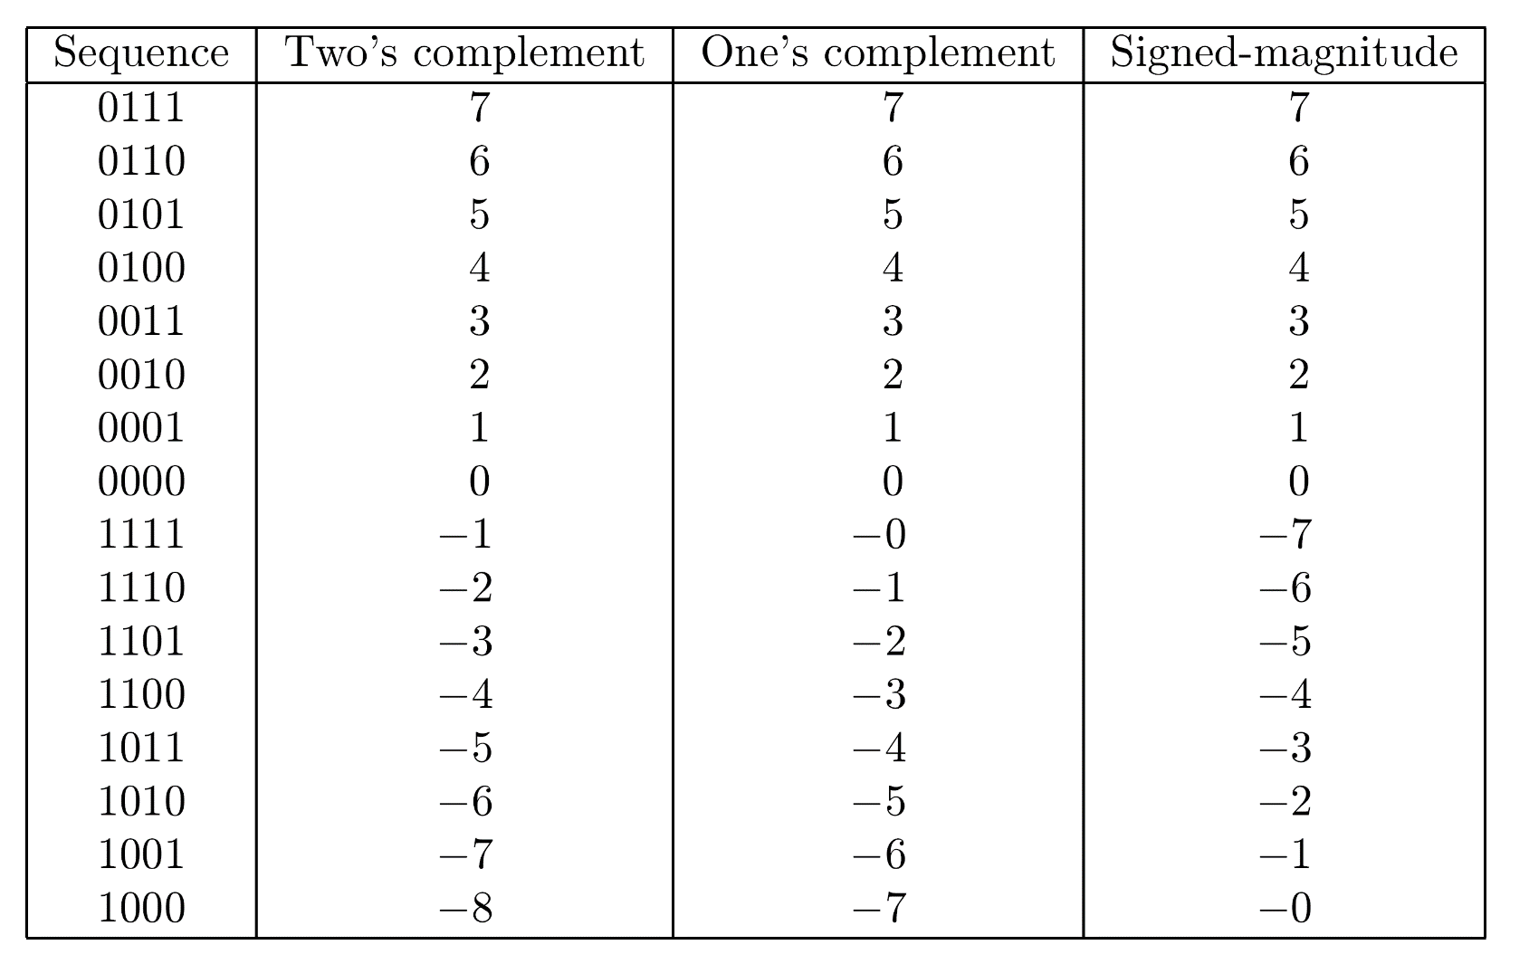
The Two’s Complement Representation

Slide 35
Example - Addition in Two’s complement
Calculating X+(-Y) with Y>X - 3+(-5) 0011 3 + 1011 -5 1110 -2
Correct result represented in the two's complement method - no need for preliminary decisions or post corrections
Calculating X+(-Y) with X>Y - 5+(-3) 0101 5 + 1101 -3 1 0010 2
Only the last four least significant digits are retained, yielding 0010

Slide 36
A 2nd Alternative for R : Diminished-Radix Complement Representation
k
Selecting R as R=r - ulp
This is the diminished-radix complement
R - X =(r - ulp ) - X = X
Derivation of the complement is simpler than the radix complement
All the digit-complements xi can be calculated in parallel - fast computation of X
A correction step is needed when R+(X-Y) is obtained and X-Y is positive
k
-
-
-

Slide 37
Example - One’s Complement in Binary System
0
r=2, k=n=4, m=0, ulp=2 =1
Diminished-radix complement (called one's complement in the binary case) of a number X = (2 - 1) - X = X
As before, the sequences 0000 to 0111 represent the positive numbers 010 to 710
The one's complement of 0111 is 1000, representing (-7)10
The one's complement of zero is 1111 - two representations of zero
Range of representable numbers is -7 ≤ X ≤ 7
4
-

Slide 38
Comparing the Three Representations in a Binary System

Slide 39
Range of Representable Numbers in Complement Methods
Binary system - most significant digit is 0 or 1 - a “true" sign digit in all three methods
Non-binary system - restricting the most significant digit to 0 and r-1 reduces the number of utilized sequences to 2r out of r
Alternative - let the most significant digit assume all values and partition r equally between positive and negative values
To have unambiguous representations, the regions for positive and negative numbers should not overlap - |X| ≤ R/2
If X=R/2+1 is included in the region of representable numbers, then the negative number -X is represented by R-X=R/2-1 - already representing a positive number
n-1
n
n

Slide 40
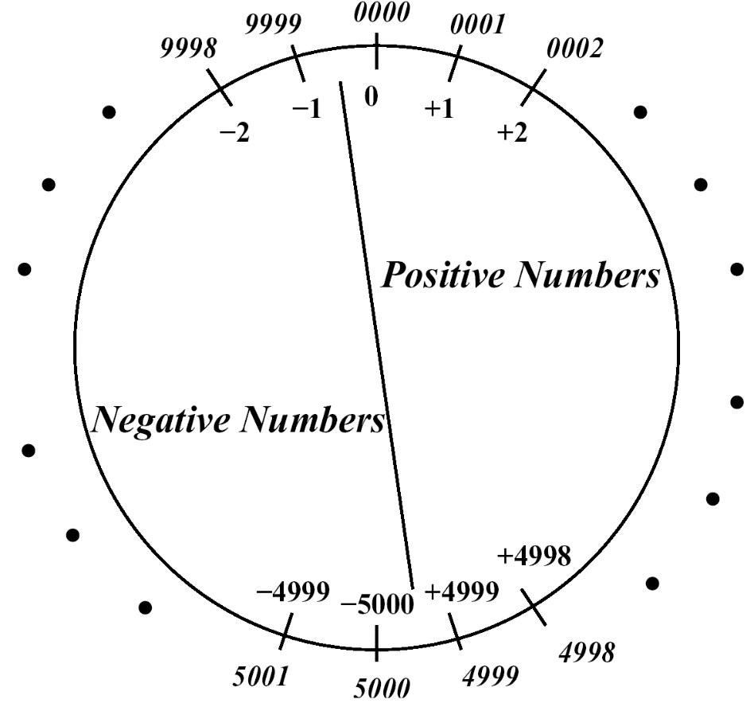
Example: Radix-Complement Decimal System
Leading digit 0,1,2,3,4 - positive
Leading digit 5,6,7,8,9 - negative
Example - n=4
0000 to 4999 - positive
5000 to 9999 - negative - (-5000) to -1
Range - -5000 ≤ X ≤ 4999
Y=1234
Representation of -Y=-1234 - radix complement R-Y with R=10
R-Y = Y + ulp
Digit complement = 9 - digit ; ulp=1
Y=8765 ; Y+1 =8766 - representation of -Y
Y+(-Y)=1234+8766=10 =0 mod 10
4
-
-
-
4
4

Slide 41
The Two's Complement Representation
From now on, the system is: r=2, k=n, ulp=1
Range of numbers in two’s complement method: -2 ≤ X ≤ 2 - ulp (ulp=2 =1)
Slightly asymmetric - one more negative number
-2 (represented by 10⋅⋅⋅0) does not have a positive equivalent
A complement operation for this number will result in an overflow indication
On the other hand, there is a unique representation for 0
n-1
n-1
0
n-1

Slide 42
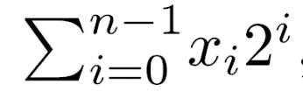
Numerical Value of a Two’s Complement Representation
Numerical value X of representation (xn-1,xn-2,...,x0) in two's complement -
If xn-1=0 - X =
If xn-1=1 - negative number - absolute value obtained by complementing the sequence (i.e., complementing each bit and adding 1) and adding a minus sign
Example - Given the 4-tuple 1010 - negative - complementing - 0101+1=0110 - value is 6 - original sequence is -6

Slide 43
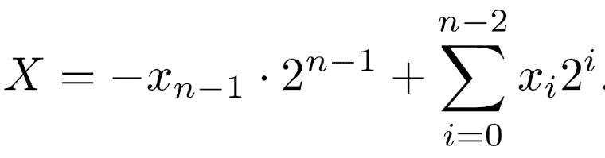
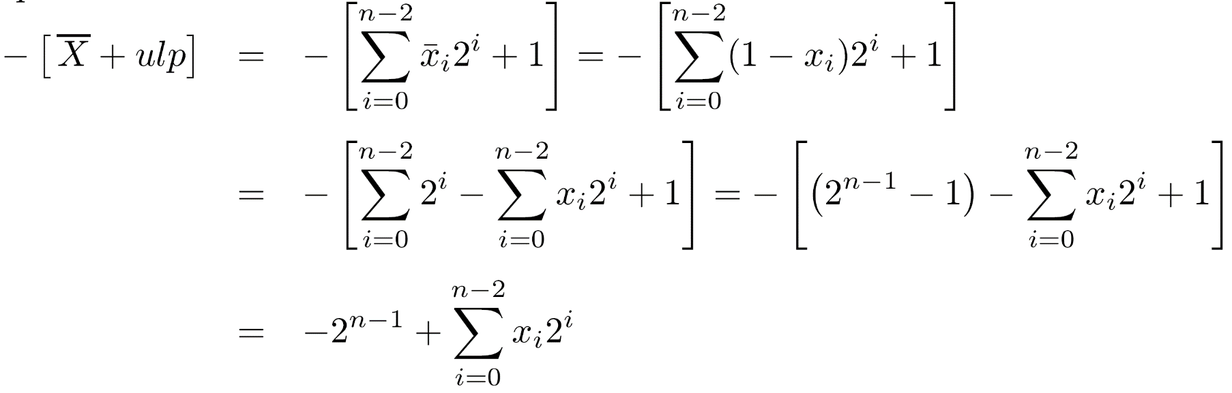
Different Calculation of Numerical Value
Example - 1010 - X=-8+2=-6
Proof - If xn-1=0 - same equation
If xn-1=1 -
which is the previous equation for xn-1=1

Slide 44
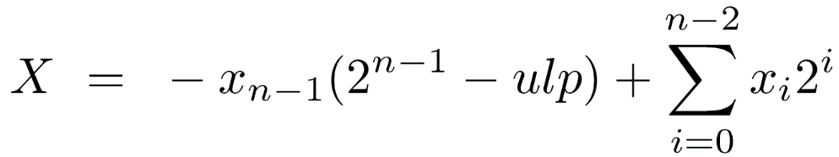
The One's Complement Representation
Derivation of one's complement - simpler than two’s complement
Calculating xi=1-xi for each digit - Boolean complement, can be done in parallel for all digits
Symmetric range of representable numbers
-(2 -ulp) ≤ X ≤ 2 - ulp (ulp=2 =1)
As a result - two representations of zero
  positive zero: 000...0; negative zero: 111...1
Calculating the numerical value of a sequence
Example - 4-tuple 1001 - X=-7+1=-6
-
n-1
n-1
0

Slide 45
Addition and Subtraction
In signed-magnitude representation -
  Only magnitude bits participate in adding/subtracting - sign bits are treated separately
  Carry-out (or borrow-out) indicates overflow
Example - 0 1001 +9 0 + 0111 +7 0 1 0000 0= 16 mod 16
Final result positive (sum of two positive numbers) but wrong
In both complement representations -
  All digits, including the sign digit, participate in the add or subtract operation
  A carry-out is not necessarily an indication of an overflow

Slide 46
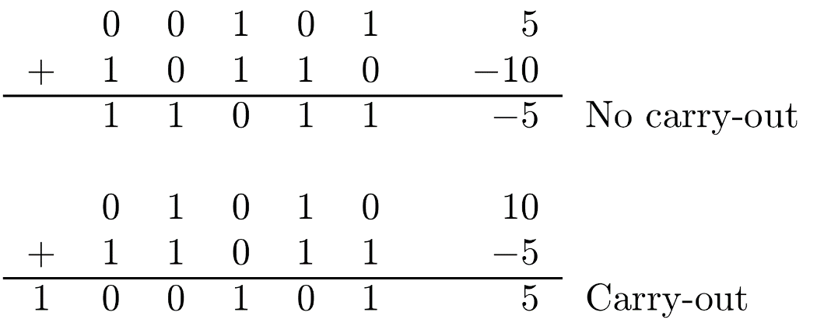
Addition/Subtraction in Complement Methods
Example - (two’s complement) 01001 9 11001 -7 1 00010 2
  Carry-out discarded - does not indicate overflow
In general, if X and Y have opposite signs - no overflow can occur regardless of whether there is a carry-out or not
Examples - (two’s complement)

Slide 47
Addition/Subtraction - Complement - Cont.
If X and Y have the same sign and result has different sign - overflow occurs
Examples - (two’s complement) 10111 -9 10111 -9 1 01110 14 = -18 mod 32
  Carry-out and overflow 01001 9 00111 7 0 10000 -16 = 16 mod 32
  No carry-out but overflow

Slide 48
Addition/Subtraction - One’s Complement
Carry-out - indicates the need for a correction step
Example - adding positive X and negative -Y
X+(2 - ulp )-Y =(2 - ulp)+(X-Y)
If X>Y - correct result is X-Y
2 represents the carry-out bit - discarded in a register of length n
Result is X-Y-ulp - corrected by adding ulp
Example - 01001 9 + 11000 -7 1 00001 Correction 1 ulp 00010 2
The generated carry-out is called end-around carry - it is an indication that a 1 should be added to the least significant position
n
n
n

Slide 49
Addition/Subtraction - One’s Complement -Cont.
If X<Y - the result X-Y=-(Y-X) is negative
Should be represented by (2 -ulp) - (Y-X)
There is no carry-out - no correction is needed
Example - 10110 -9 00111 7 11101 -2
No end-around carry correction is necessary in two's complement addition
n

Slide 50
Subtraction
In both complement systems - subtract operation, X-Y, is performed by adding the complement of Y to X
In the one's complement system - X-Y=X+Y
In the two's complement system - X-Y=X+(Y+ulp )
This still requires only a single adder operation, since ulp is added through the forced carry input to the binary adder
-
-

Slide 51
Arithmetic Shift Operations
Another way of distinguishing among the three representations of negative numbers - the infinite extensions to the right and left of a given number
Signed-magnitude method - the magnitude xn-2,..., x0 can be viewed as the infinite sequence …,0,0,{xn-2,...,x0},0,0,...
Arithmetic operation resulting in a nonzero prefix - an overflow
Radix-complement scheme - the infinite extension is …,xn-1,xn-1,{xn-1,...,x0},0,0,… (xn-1 - the sign digit)
Diminished-radix complement scheme - the sequence is …,xn-1,xn-1,{xn-1,...,x0},xn-1,xn-1,…

Slide 52
Arithmetic Shift Operations - Examples
1010., 11010.0, 111010.00 - all represent -6 in two's complement
1001., 11001.1, 111001.11 - all represent -6 in one's complement
Useful when adding operands with different numbers of bits - shorter extended to longer
Rules for arithmetic shift operations: left and right shift are equivalent to multiply and divide by 2, respectively
Two’s complement One’s complement Sh.L{00110=6}=01100=12 Sh.L{11001=-6}=10011=-12 Sh.R{00110=6}=00011=3 Sh.R{11001=-6}=11100=-3 Sh.L{11010=-6}=10100=-12 Sh.R{11010=-6}=11101=-3

